Slide 1

Flow Control
School of Computer Science Engineering and Technology Bennett University
Greater Noida – 201310

Slide 2
Go Back N ARQ
Outline
Selective Repeat ARQ

Slide 3
Go Back N ARQ
Go-Back-N ARQ is an Automatic Repeat Request (ARQ) protocol where the sending process continues to send several frames as specified by the window size even without receiving an ACK packet from the receiver.
The sender keeps a copy of each frame until the arrival of ACK.
In Go-Back-N ARQ, the size of the sender is N and the size of the receiver window is always 1.
This receiver starts a new ACK timer once it receives packets from sender. When the timer expires then the receiver sends the cumulative acknowledgement for all the frames that are unacknowledged by the receiver at that moment.

Slide 4
Go Back N ARQ II
If the receiver receives a corrupted frame, then it silently discards that corrupted frame, and the correct frame is retransmitted by the sender after the timeout timer expires.
If the receiver receives the out of order frame, then it simply discards all the frames.
If the sender does not receive any acknowledgement, then the entire window of
the frame will be retransmitted in that case.
Using the Go-Back-N ARQ protocol leads to the retransmission of the lost frames after the expiry of the timeout timer.
𝑡_{𝑝}
𝑡_{𝑡}
Efficiency = Sender Window Size in Protocol / (1 + 2a) where 𝑎 =

Slide 5
Need of Go Back N ARQ
This protocol is used to send more than one frame at a time. With the help of Go- Back-N ARQ, there is a reduction in the waiting time of the sender.
With the help of the Go-Back-N ARQ protocol the efficiency in the transmission increases.

Slide 6
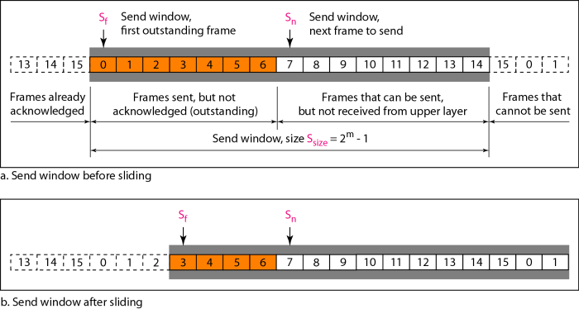
Go Back N ARQ Sender sliding window
Send sliding window: An imaginary box that covers the sequence numbers of the data frame which can be in transit.
Whenever a valid acknowledgement arrives then the send window can slide one or more slots.
Sender window size : The value of N must be greater than 1. If N is equal to 1 then this protocol becomes a stop-and-wait protocol.

Slide 7
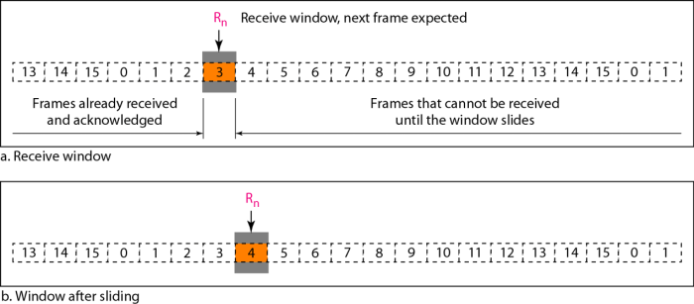
Go Back N ARQ receiver sliding window
Receive window is an imaginary box with size 1.
Slides one slot at a time when a correct frame arrives.
The receiver always looks for a specific frame to arrive in the specific order. Out of order packet is discarded and thus need to be resent by the sender.
If a frame arrives at the receiver safely and in- order then the receiver send ACK back to the sender.
The silence of the receiver causes the timer of the unacknowledged frame to expire.

Slide 8
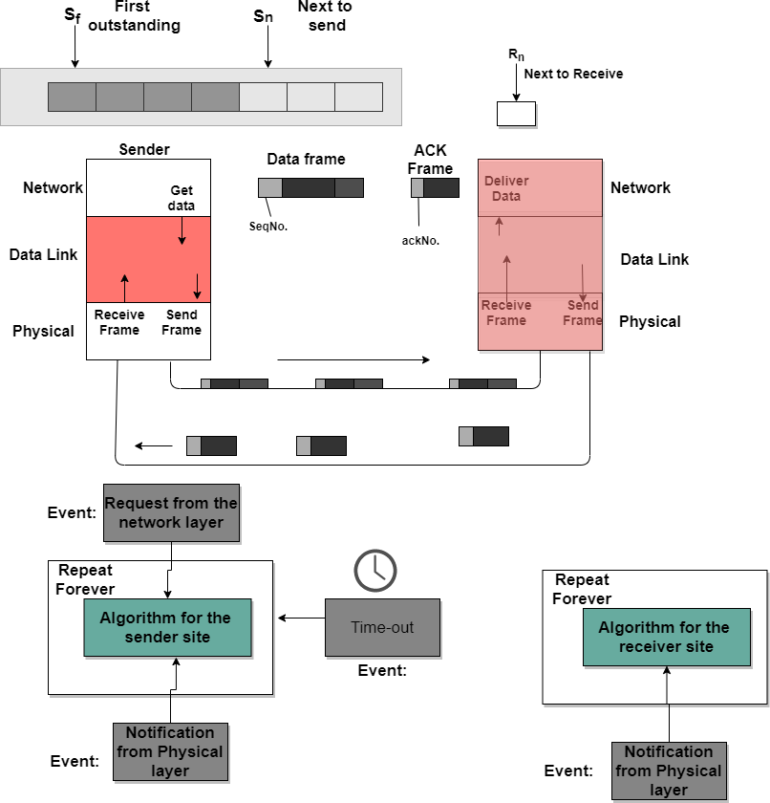
Design of Go Back N ARQ

Slide 9
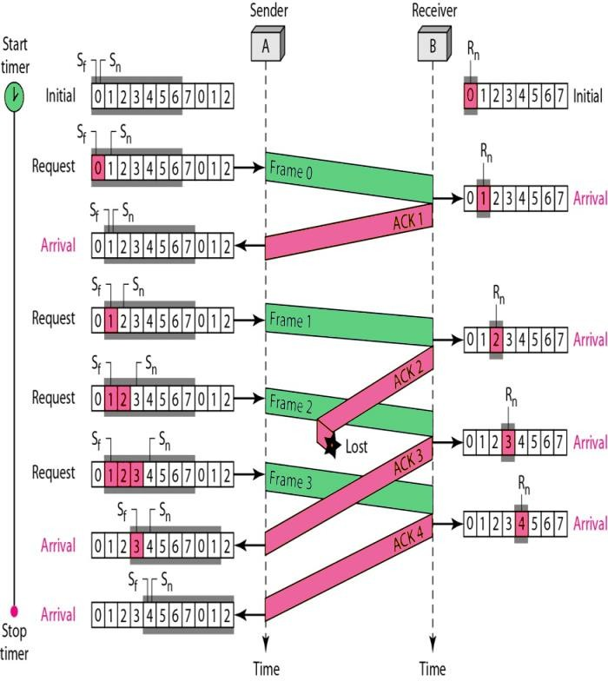
Flow Diagram

Slide 10
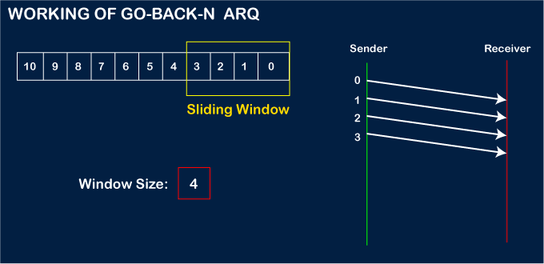
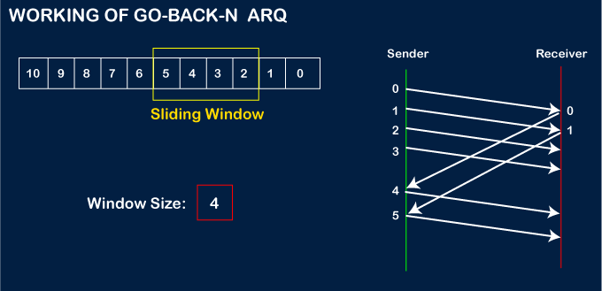
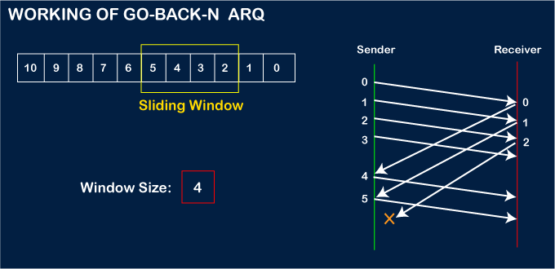
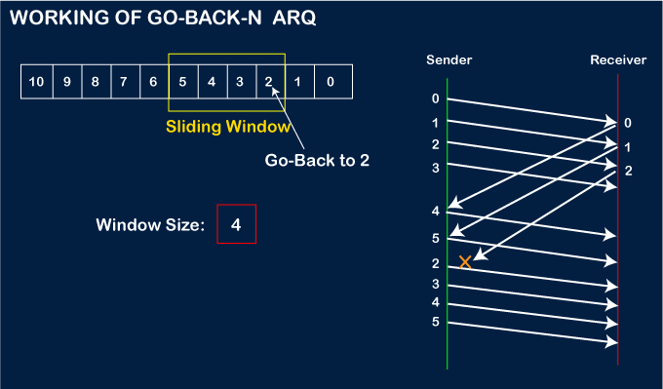

Slide 11
Go Back N ARQ: Advantages & Disadvantages
Advantages Disadvantages
The efficiency of this protocol is more.
Timeout timer runs at the receiver side only.
The waiting time is pretty much low in this protocol.
The transmitter needs to store the last N packets.
With the help of this protocol, the timer can be set for many frames.
The retransmission of many error-free
packets follows an erroneous packet.
Also, the sender can send many frames at a time.
Only one ACK frame can acknowledge more than one frame.

Slide 12
Go Back N ARQ Numerical
A 20 Kbps satellite link has a propagation delay of 400 ms. The transmitter employs the “go back n ARQ” scheme with n set to 10. Assuming that each frame is 100 bytes long, what is the network throughput?
Sol: Bandwidth = 20 Kbps = 20,000 bits/sec
Propagation delay = 400 ms = 0.4 sec
Go-Back-N window size (n) = 10
Frame size = 100 bytes = 800 bits
Step 1: Transmission time of one frame
Transmission time (Tt) = Frame size / Bandwidth
Tt = 800 / 20000 = 0.04 sec = 40 ms
Step 2: Round Trip Time (RTT)
RTT = 2 × Propagation delay = 2 × 0.4 = 0.8 sec

Slide 13
Go Back N ARQ Numerical
Step 3: Bandwidth-Delay Product (BDP)
BDP = Bandwidth × RTT = 20000 × 0.8 = 16000 bits
Number of frames that can fill the pipe: 16000 / 800 = 20 frames
So, to fully utilize the link, window size should be 20 frames. But given window size = 10 frames, which is smaller than required.
Step 4: Time to send 10 frames
Time to send 10 frames = 10 × 0.04 = 0.4 sec
After sending 10 frames, sender must wait for ACK.
ACK for first frame comes after:
Tt + RTT = 0.04 + 0.8 = 0.84 sec
So total cycle time = 0.84 sec
Step 5: Throughput Calculation
Data successfully sent in one cycle = 10 frames = 10 × 800 = 8000 bits
Throughput = Data / Total time = 8000 / 0.84 Throughput ≈ 9523.8 bits/sec
≈ 9.52 Kbps
Network Throughput ≈ 9.52 Kbps

Slide 14
Go Back N ARQ Self Practice Numerical
Q. A 1 Mbps satellite link connects two ground stations. The altitude of the satellite is 36504 km and speed of the signal is 3 x 108 m/sec. What should be the packet size for a channel utilization of 50% for a satellite link using go back 254 sliding window protocol?

Slide 15
Selective Repeat ARQ
The sender window size is always same as receiver window size (2^{𝑛} − 1, where n is the number of bits available for sequence number).
Receiver acknowledges each frame independently to the sender.
It does not accept the corrupted frames but does not silently discard them.
Receiver handles the situation efficiently by sending a negative acknowledgement (NACK).
NACK allows early retransmission of the corrupted frame.
It also avoids waiting for the time out timer to expire at the sender side to retransmit the frame.
It accepts the out of order frames and sort the frames in a correct order at the receiver’s side.
It requires searching at the sender’s side for sending the missing frame to the receiver.
Retransmission of lost frames after expiry of time out timer at the sender end.
Efficiency = N / (1 + 2a)

Slide 16
Selective Repeat ARQ: Retransmission Request
Implicit Retransmission request: It's the receiver's duty to acknowledge or give positive feedback of received data packet and negative feedback for those which were lost or damaged during transmission, and that too before the expiry of time out timer.
Explicit Retransmission request: In explicit retransmission, the receiver can request retransmission of just one packet.

Slide 17
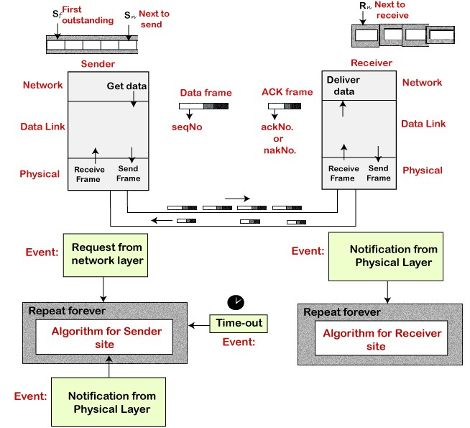
Design of Selective Repeat ARQ

Slide 18
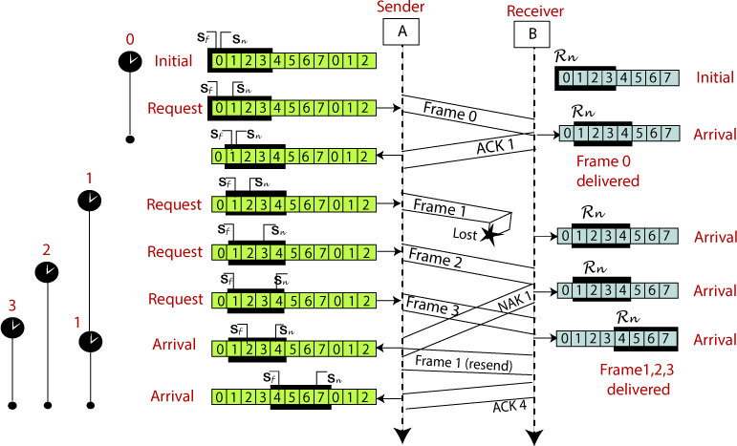
Selective Repeat ARQ Example

Slide 19
 | Stop and Wait ARQ | Go back N | Selective Repeat | Remarks
Efficiency | 1 / (1+2a) | N / (1+2a) | N / (1+2a) | Go back N and Selective Repeat gives better efficiency than Stop and Wait ARQ.
Window Size | Sender Window Size = 1 Receiver Window Size = 1 | Sender Window Size = N Receiver Window Size = 1 | Sender Window Size = N Receiver Window Size = N | Buffer requirement in Selective Repeat is very large. If the system does not have lots of memory, then it is better to choose Go back N.
Minimum number of sequence numbers required | 2 | N+1 | 2 x N | Selective Repeat requires large number of bits in sequence number field.
Retransmissions required if a packet is lost | Only the lost packet is retransmitted | The entire window is retransmitted | Only the lost packet is retransmitted | Selective Repeat is far better than Go back N in terms of retransmissions required.
Bandwidth Requirement | Bandwidth requirement is Low | Bandwidth requirement is high because even if a single packet is lost, entire window has to be retransmitted. | Bandwidth requirement is moderate | Selective Repeat is better than Go back N in terms of bandwidth requirement.
CPU usage | Low | Moderate | High due to searching and sorting required at sender and receiver side | Go back N is better than Selective Repeat in terms of CPU usage.
Level of difficulty in Implementation | Low | Moderate | Complex as it requires extra logic and sorting and searching | Go back N is better than Selective Repeat in terms of implementation difficulty.
Acknowledgements | Uses independent acknowledgement for each packet | Uses cumulative acknowledgements (but may use independent acknowledgements as well) | Uses independent acknowledgement for each packet | Sending cumulative acknowledgements reduces the traffic in the network but if it is lost, then the ACKs for all the corresponding packets are lost.
Type of Transmission | Half duplex | Full duplex | Full duplex | Go back N and Selective Repeat are better in terms of channel usage.

Slide 20
References
https://www.javatpoint.com/go-back-n-arq
https://www.studytonight.com/computer-networks/gobackn-automatic-repeat-request
https://www.geeksforgeeks.org/sliding-window-protocol-set-2-receiver-side/
https://www.youtube.com/watch?v=ZLtkhsgQp8U&t=2488s
https://www.youtube.com/watch?v=Oipm5DdYYAs
https://www.youtube.com/watch?v=WfIhQ3o2xow
https://www.youtube.com/watch?v=QD3oCelHJ20

